Slide 1
Management
PhD in Business Economics
Luis D. Torres, PhD.

Slide 2
Agenda
Corporate Governance Theories
Critically analyse the three pillars of governance theory: Agency, Transaction Cost Economics (TCE), and Resource Dependence (RDT).
Understand the "firm" as a nexus of contracts and a governance structure rather than a production function.
Assess the empirical validity and boundary conditions of these theories.
Hands on: Search the literature of the last 2 years and identify key topics in corporate governance as well as the theoretical approach used.

Slide 3
What is corporate governance?
How do we define good corporate governance?
What is the purpose of corporate governance theories?
How is corporate governance related with organisation and management theory?
Notes:
Corporate governance theories explore how companies are controlled and operated
Organizational theory refers to a management insight that can help explain or describe organizational behaviors, designs, or structures within various types of organizations and their activities, processes, and environments.

Slide 4
Traditionally ownership = control
Shareholders are the managers
Most modern corporations (not all of them): Separation of ownership and control
Shareholders
Shareholders
Run
Company
Senior executives
Run
Company
Notes:
Modern corporations are more often managed (controlled) by “agents” (managers) who have a fiduciary duty to fulfil the goals and mission given them by its “principals” (shareholders)

Slide 5
G20/OECD Principles of Corporate Governance 2023
Corporate governance involves a set of relationships between a company’s management, board, shareholders and stakeholders. Corporate governance also provides the structure and systems through which the company is directed and its objectives are set, and the means of attaining those objectives and monitoring performance are determined.
Narrow (old) sense: shareholders + management
Broader (modern) sense: shareholders + stakeholders + management

Slide 6
G20/OECD Principles of Corporate Governance 2023
Basic shareholder rights should include the right to:
secure methods of ownership registration;
convey or transfer shares;
obtain relevant and material information on the corporation on a timely and regular basis;
participate and vote in general shareholder meetings;
elect and remove members of the board;
share in the profits of the corporation; and
elect, appoint or approve the external auditor.

Slide 7
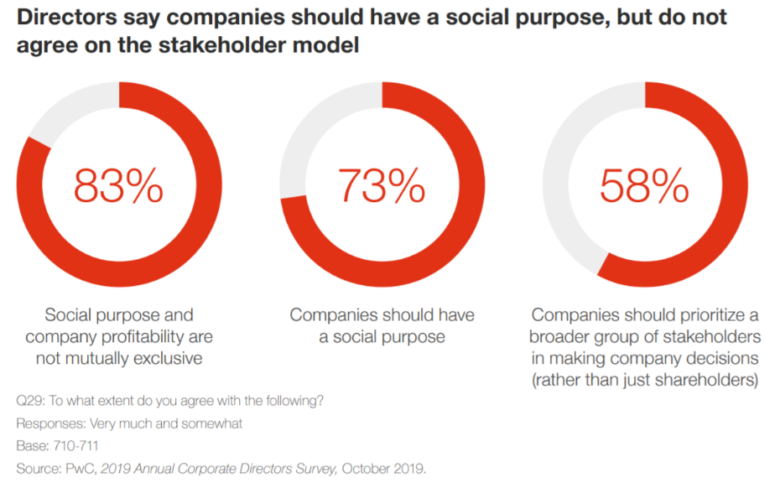

Slide 8
Corporate Governance – Different Models
 | Anglo-American model | France, Italy & Germany (Cont. Europe model) | Russia | India | China | Brazil
Ownership structure | Dispersed | Concentrated | Concentrated | Highly concentrated | Highly concentrated | Highly concentrated
Ownership identity | Individuals Pension and mutual funds | Banks Corporations State | Owner-managers Employees State | Families Foreign investors Banks | State Families Corporations | Family owned business groups State
Changes in ownership | Frequent | Rare | Frequent, but decreasing tendency | Traditionally extremely rare, but recently changing | Rare, but increasingly dynamic | Rare Increasing influence of foreign investors
Goals of ownership | Shareholder value Short term profits | Sales, market share, headcount Long term ownership | Profit for owners Long term ownership | Long term ownership Growth of market shares | Long term ownership Sales, market share | Long term ownership Profit for owners
Board controlled by | Executives Shareholders | Shareholders Employees | Owner-managers Other insiders | Owners Other insiders | Owners Party/the state | Owners/ shareholders
Key stakeholders | Shareholder | Owners Employees | Owners State | Owners Customers in overseas markets | Owners Guanxi-network | Owners Customers in overseas markets

Slide 9
What about?
Chile
Peru

Slide 10
(main) Theories of corporate governance
Agency theory
Transaction costs economics
Resource dependence theory
But there are many more…
Stakeholder theory
Stewardship theory
Information asymmetry theory
…

Slide 11
Agency theory and the nexus of contracts
Explains the relationship between the owners (principals) of a company and the managers (agents) who run it. It aims at minimize conflicts of interest and ensure managers act in the best interests of the “owners”.
The definition of the firm
Traditional economics viewed the firm as a production function
The firm is a "legal fiction" serving as a nexus for contracting relationships among individuals.
Behaviour is the outcome of a complex equilibrium process similar to a market.
Agency costs and ownership structure
The sum of monitoring expenditures by the principal, bonding expenditures by the agent, and residual loss.
Managers who do not own 100% of the firm will appropriate perks because they do not bear the full cost of their consumption.
Principal-agent problem: managers acting in their own self-interest rather than the shareholders' interests, leading to conflicts of interest.
Jensen & Meckling (1976); Fama & Jensen (1983)

Slide 12
Agency theory and the nexus of contracts
Separation of decision management and decision control
Governance survives by separating Decision Management (initiation and implementation) from Decision Control (ratification and monitoring).
The Board of Directors functions as the centre of the decision control system with the power to hire, fire, and compensate top management.
Typical areas of research:
It proposes governance mechanisms like executive compensation, board oversight, and shareholder rights to align the interests of managers and shareholders.

Slide 13
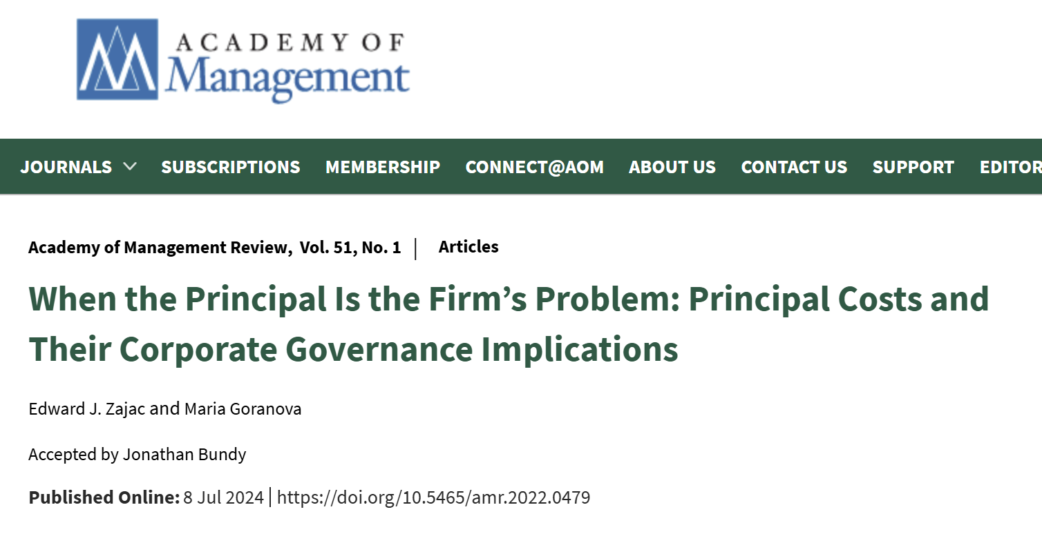

Slide 14
Transaction Cost Economics Theory
The transaction as the unit of analysis
It focuses on the transaction as the unit of analysis and seeks to identify the most efficient way to organize economic activity by minimising costs.
The central claim is that firms will align transaction characteristics with governance structures in a way that minimizes the sum of production and transaction costs.
It relies on two core assumptions about human behaviour that make transaction-specific governance necessary:
Bounded rationality: Human agents have a limited ability to receive, store, and process information, which makes it impossible to write complete contracts that cover every possible future contingency.
Opportunism: This is defined as self-interest seeking with guile. It assumes that some individuals may provide false or misleading information to gain a strategic advantage.
Williamson (1979); David & Han (2004)

Slide 15
Transaction Cost Economics Theory
The three dimensions of transactions:
Asset specificity: The degree to which assets (physical or human) used for a transaction can be redeployed to alternative uses without a loss of productive value. High asset specificity creates bilateral dependency, where parties are effectively locked into the relationship.
Uncertainty: This refers to the unpredictability of future events. According to TCE, uncertainty's impact is conditional. It only affects the choice of governance when asset specificity is present.
Frequency: The regularity with which a transaction occurs. High-frequency transactions can more easily justify the bureaucratic costs of setting up a specialised governance structure

Slide 16
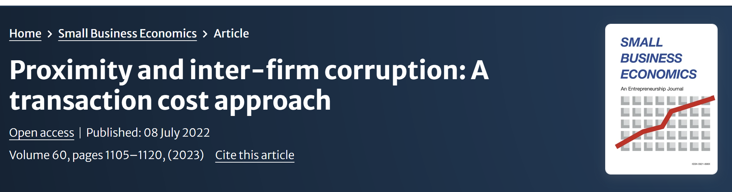
Transaction Cost Economics Theory
Typical areas of research:
Agency problem, board of directors' role, corporate governance structure, vertical integration, contract designs, merge and acquisitions.

Slide 17
Resource Dependence Theory
It characterises the corporation as an open system that is fundamentally dependent on contingencies in its external environment.
The theory is built on several foundational arguments regarding how organisations interact with their surroundings:
Interdependence and constraint: Organisations are not autonomous; they are constrained by a network of interdependencies with other organisations.
Uncertainty and survival: When interdependence is coupled with uncertainty about the actions of others, an organisation's survival and continued success become uncertain.
Strategic action: Managers act to reduce this environmental uncertainty and dependence by taking specific actions to manage external interdependencies.
Power dynamics: Central to RDT is the concept of power, defined as the control over vital resources. Organisations strive to reduce the power others have over them while often attempting to increase their own power over others.
Hillman, Withers & Collins (2009)

Slide 18
Resource Dependence Theory
Five primary options that firms can enact to minimise environmental dependencies:
Mergers and Acquisitions (M&As): Firms use M&As to reduce competition by absorbing competitors, manage interdependence with buyers or suppliers, and diversify operations to lessen dependence on specific exchange partners.
Joint Ventures (JVs) and interorganisational relationships: These include strategic alliances and R&D agreements that provide a partial absorption of interdependencies. They are used to acquire resources and reduce environmental complexity, particularly when organizations are mutually dependent.
Boards of Directors: This is an area of significant RDT influence. Boards provide four key benefits:
Advice and counsel (information).
Channels of information between the firm and environmental contingencies.
Preferential access to resources.
Legitimacy for the organization.
Political action: Firms engage in corporate political activity to create a more favourable environment. This includes shaping government regulations to reduce uncertainty and creating co-optive linkages with political decision-makers, which has been shown to yield financial benefits.
Executive succession: Succession is viewed as an internal strategic response to environmental contingencies. Replacing a CEO with someone capable of coping with specific critical problems can remedy a misalignment between the organization and its environment.
Notes:
The return of State-led governance—characterized by mechanisms like golden shares (which grant the State veto power over key corporate decisions) and national security interventions—directly challenges the foundational "efficiency" assumptions of Agency Theory and Transaction Cost Economics (TCE).
According to the provided papers, these theories assume that firm structures and governance choices are driven by a singular logic of private cost-minimization and value-maximization. The State’s return as a primary actor replaces these market-driven mechanics with political and strategic objectives.

Slide 19
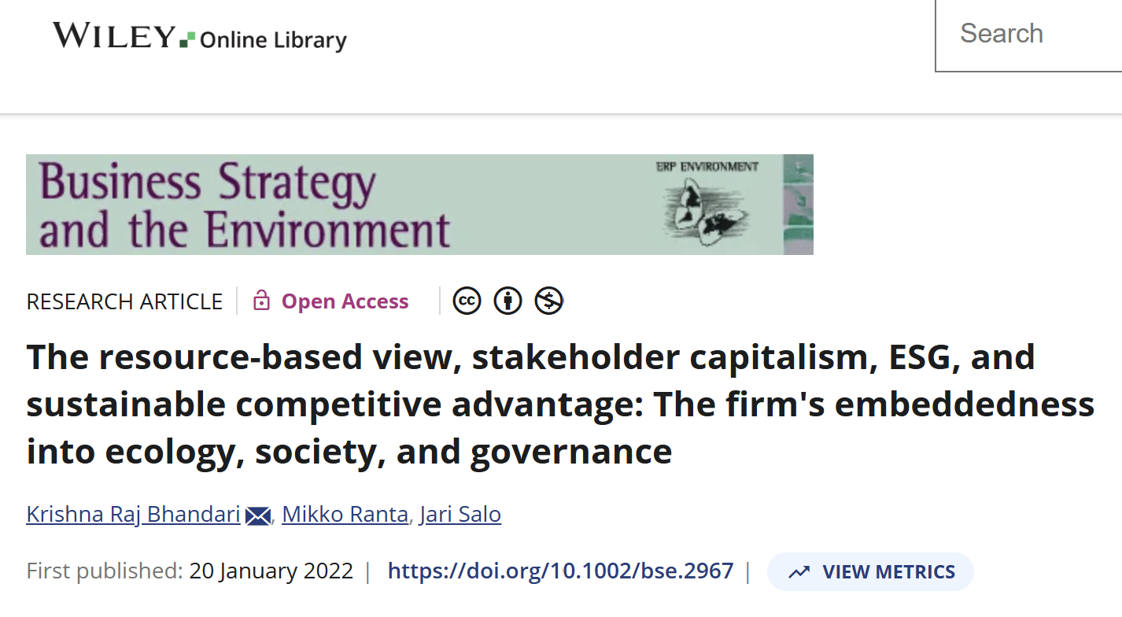

Slide 20
Theory integration
Read: https://www.ecgi.global/publications/blog/corporate-governance-reframed-a-2026-outlook
How does the return of State-led governance (golden shares, national security) invalidate the efficiency assumptions of both Agency and TCE?

Slide 21
Management
PhD in Business Economics
Luis D. Torres, PhD.

